Slide 1
Volvo Truck Analytics
Ioannis Batsios, William Downs, Wahab Ehsan, James Polk, and Christopher Thacker

Slide 2
General Overview
Basic Data Statistics and Analysis
Utility functions (Wahab)
Display Data by Day
Estimator
Outlier Detection
GPS Speed vs. Wheel-Based Speed (Chris)
External Temperature vs. Components (Ioannis)
CPU Load (James)
APU Investigation (Bill)

Slide 3
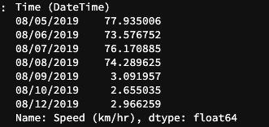

Display Data per Day
Divided data by day using mean.
Function returns average for any attribute/column.
Truck 1 had one week worth data, but Truck 2 had only three days of data.
Truck 1
Truck 2

Slide 4
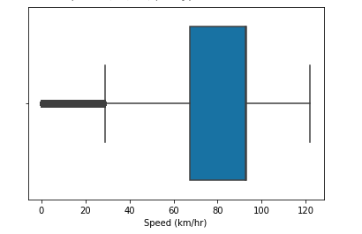
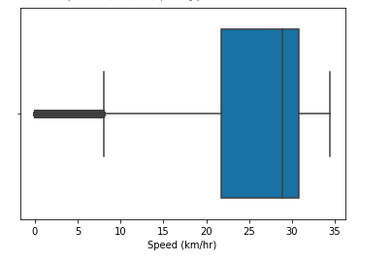
Outlier Detection
Both trucks had several outliers making the data seem scattered.
Made function to show boxplot and then had it remove outliers.
Truck 1
Before Outlier Deletion
Min: 0.0
Quartile 1: 67.22
Median: 92.60
Quartile 3: 93.15
Max: 122.05
Truck 2
Before Outlier Deletion
Min: 0.0
Quartile 1: 21.71
Median: 28.91
Quartile 3: 31.87
Max: 34.47
Truck 1
Truck 2

Slide 5
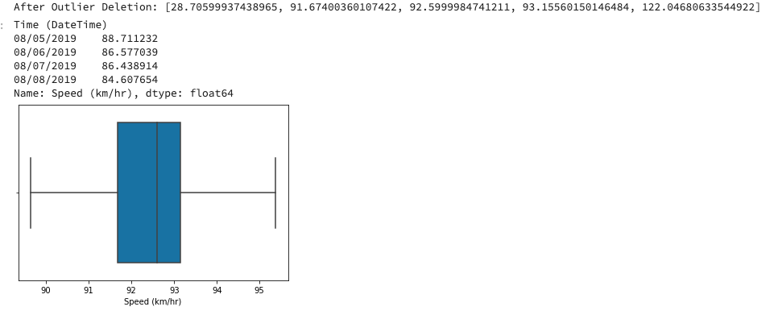
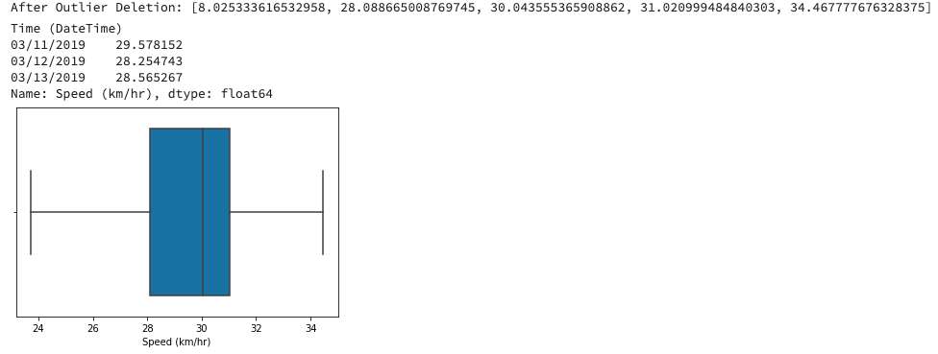
Truck 1
After Outlier Deletion
Min: 28.71
Quartile 1: 91.67
Median: 92.60
Quartile 3: 93.16
Max: 122.05
Truck 2
After Outlier Deletion
Min: 8.03
Quartile 1: 28.10
Median: 30.04
Quartile 3: 31.02
Max: 34.47

Slide 6
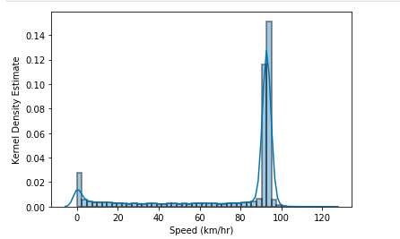
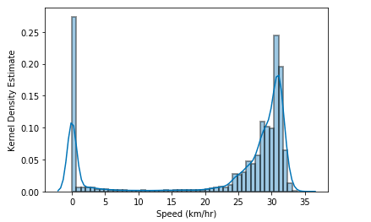
Determining the Estimator
Decided with Kernel Density Estimation (KDE).
Non-parametric estimator
There is no assumption for underlying distribution of variables.
Large Bandwidth since the data is mainly parsed around.
Truck 1
Truck 2

Slide 7
Oil Temperature
Ho: Temperature of the oil in both Trucks will remain the same.
Ha: Temperature of the oil in both Trucks will differ from each other.
Using Two Sample T-test with confidence interval of 95%.
Reject the Null hypothesis. P-value less than 0.05. Therefore, there is difference in the Oil Temperature between trucks.

Slide 8
GPS Speed vs. Wheel-Based Speed
Goals
Effectiveness of speed-measuring components.
Consistency between these components.
Basic understanding & exploration of data.
Basic data statistics.
Long-haul or short-haul?
 | Truck 1 |  | Truck 2
 | GPS Speed | Wheel-Based Speed | GPS Speed | Wheel-Based Speed
Mean | 74.55 km/hr (46.32 mph) | 74.83 km/hr (46.50 mph) | 22.69 km/hr (14.10 mph) | 82.13 km/hr (51.04 mph)
Standard Deviation | 31.94 km/hr (19.85 mph) | 31.96 km/hr (19.86 mph) | 12.18 km/hr (7.57 mph) | 44.08 km/hr 27.39 mph

Slide 9
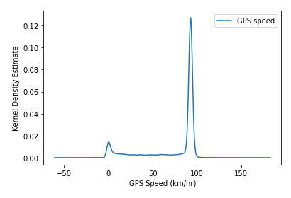
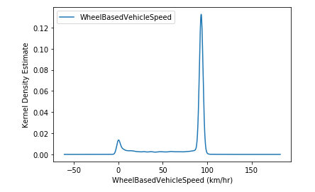
Truck 1: KDE Distributions

Slide 10
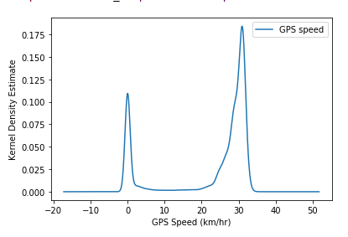
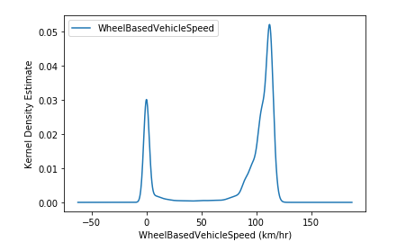
Truck 2: KDE Distributions

Slide 11
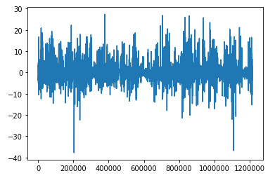
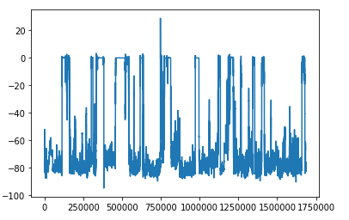
Difference in Speeds within Trucks
Truck 1
Truck 2

Slide 12
Hypothesis Testing for Speeds
For these two speed components:
A hypothesis test that will be performed is set up as:
H0: There are no differences in speeds between the two components.
Ha: There is a significant difference in speed between the two components.
Indicates two-tailed test (Scipy defaults to this).
Since distribution is binomial:
Two-sample t-test will be used.
Central Limit Theorem required.
Though Truck 2 has faulty data, the same test will still be ran on Truck 2 for good measure but only Truck 1’s test will be shown.

Slide 13
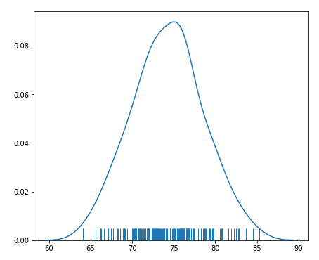
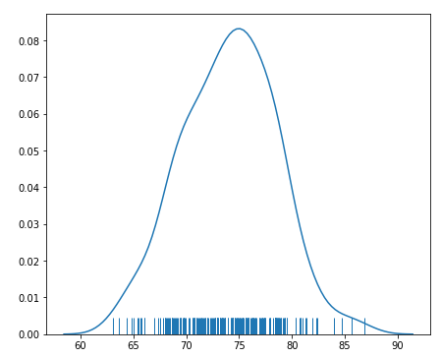
Using the Central Limit Theorem for Truck 1
Truck 1: 200 Samples of Size 50 for Both Components
GPS Speed
Wheel-Based
Vehicle Speed

Slide 14
Two-Sample T-Test Results on Truck 1
Two-Sample T-Test:
Confidence level of 95%.
Alpha level of 0.05.
Using Scipy’s built-in two-sample t-test:
P-value was ~0.613
Higher than alpha level of 0.05.
Thus, we fail to reject the null hypothesis and can assume that there is no significant difference between the measurements of both speed components for Truck 1.
Truck 2’s P-value was lower than 0.05 (~1.12e-233) when the same test was ran. Thus, for Truck 2, we reject the null hypothesis and conclude that there is significant difference.

Slide 15
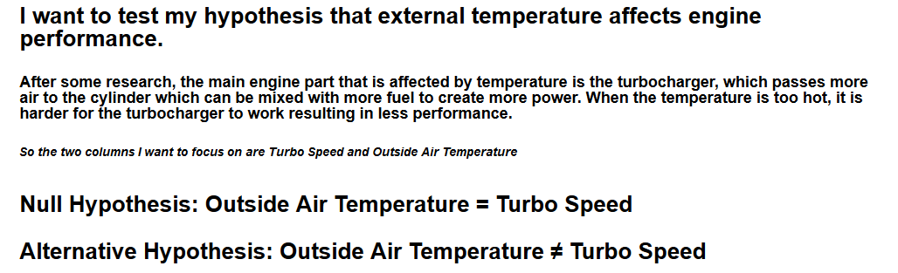
Temperature Analysis

Slide 16
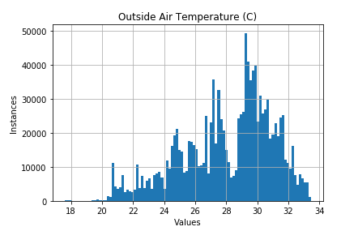
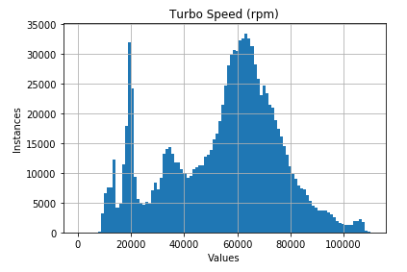
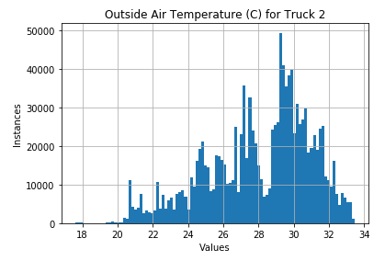
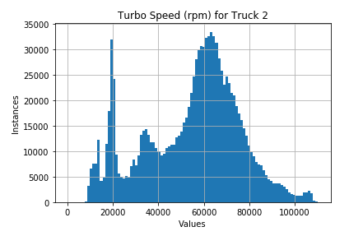
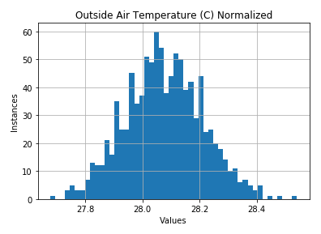
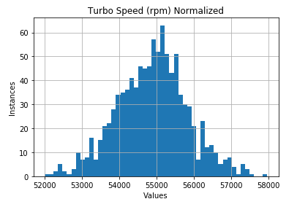
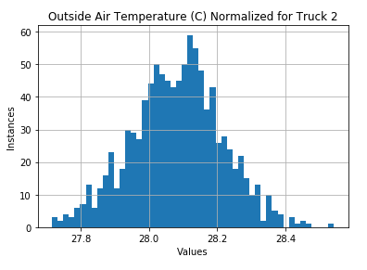
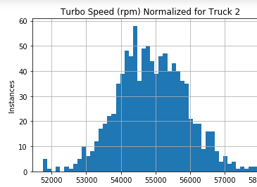
Temperature Analysis

Slide 17
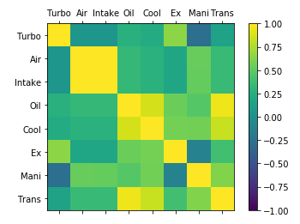
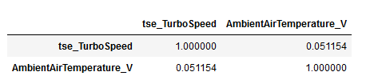

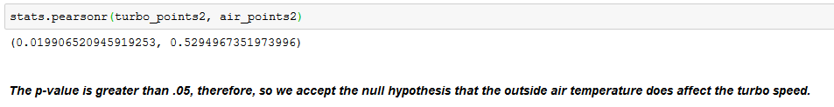
Temperature Analysis

Slide 18
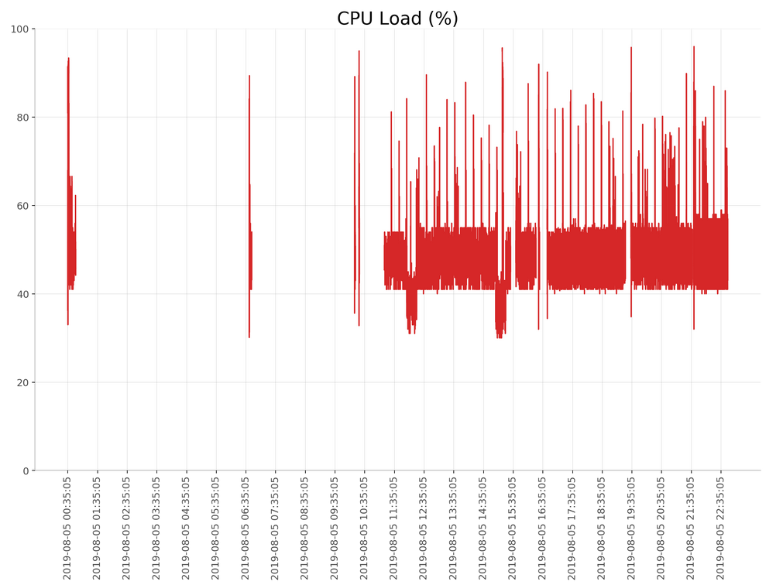
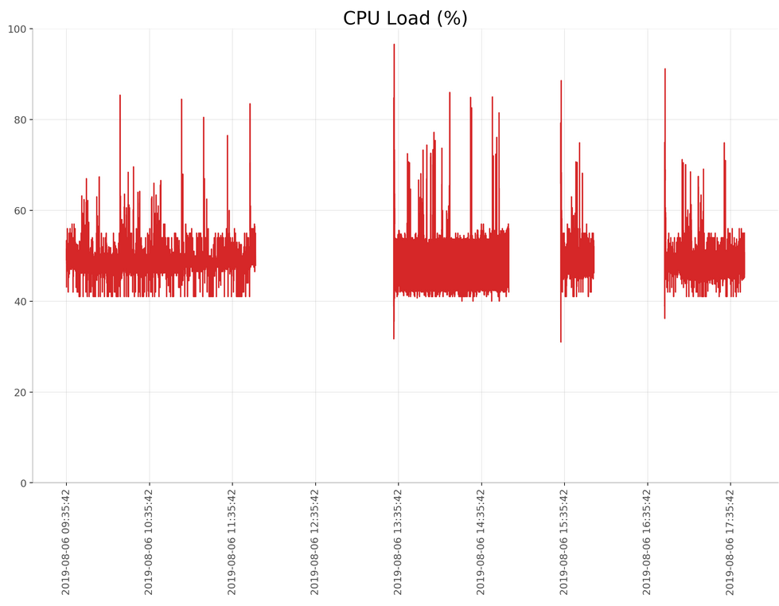
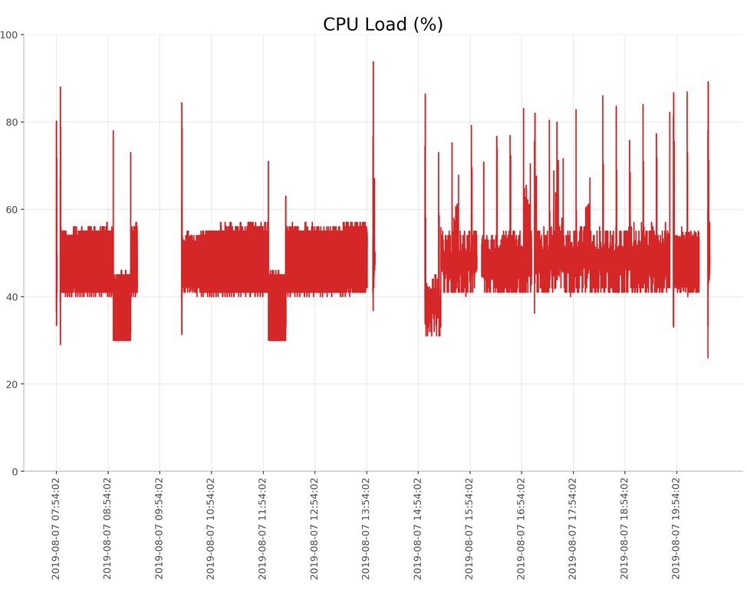
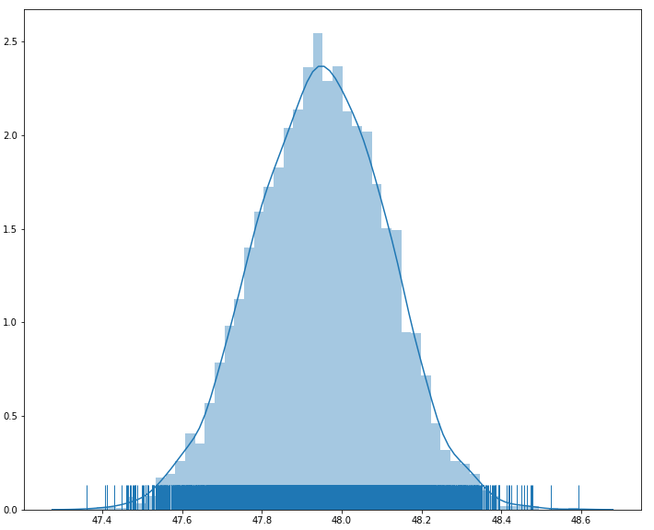
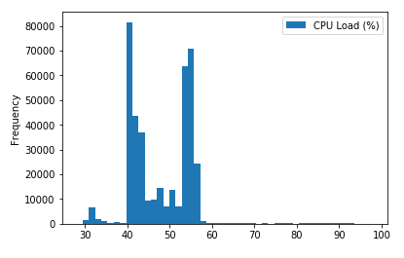
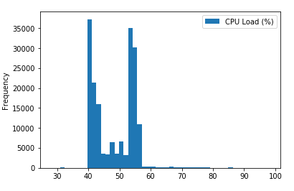
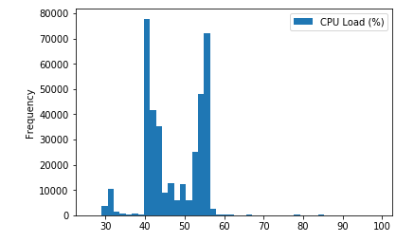
CPU Load
CPU Load (%)
count 1,200,861
mean 47.94898
std 7.225541
min 26.00000
25% 42.00000
50% 47.00000
75% 54.00000
max 99.00000
Day 1
Day 2
Day 3
CPU Sample Mean Density
6000 samples of size 2000

Slide 19
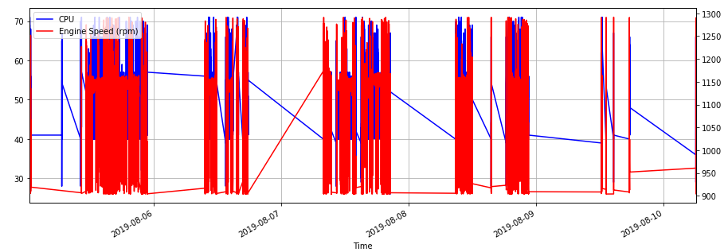
CPU Load: Why the Gaps?

Slide 20
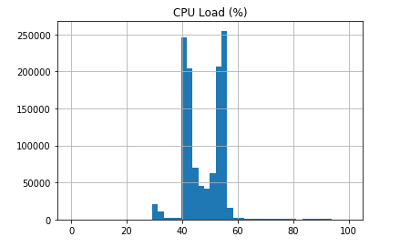
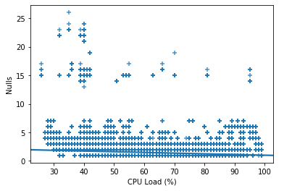
CPU Load - Linear Regression
Is the CPU Load related to the number of active sensor readings?
Correlation:
-0.11680395911398092
R2 values using k-folds cross-validation (k=3):
0.01438574935982073, 0.013693048287461984, 0.012799950799256221
No significant correlation!

Slide 21
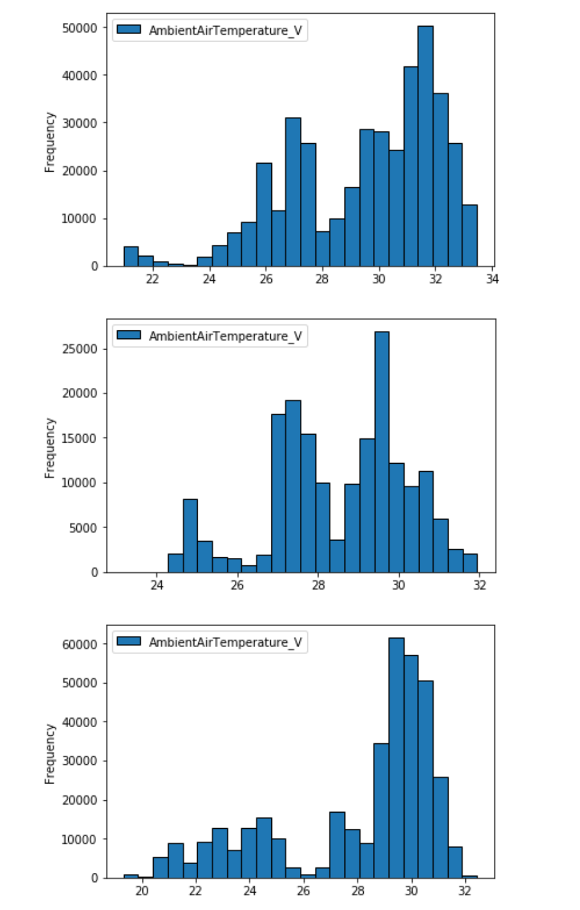
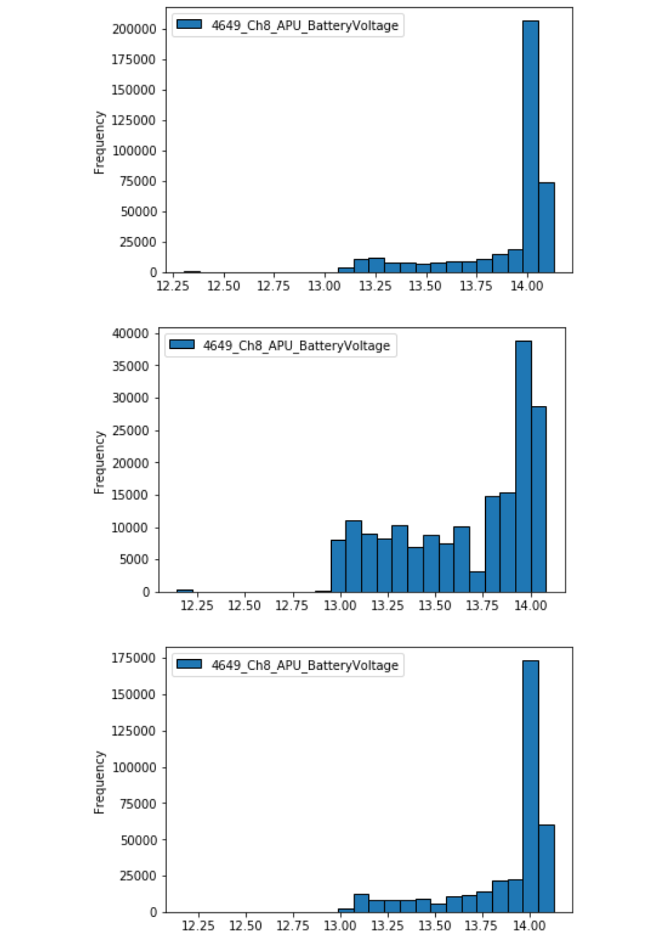
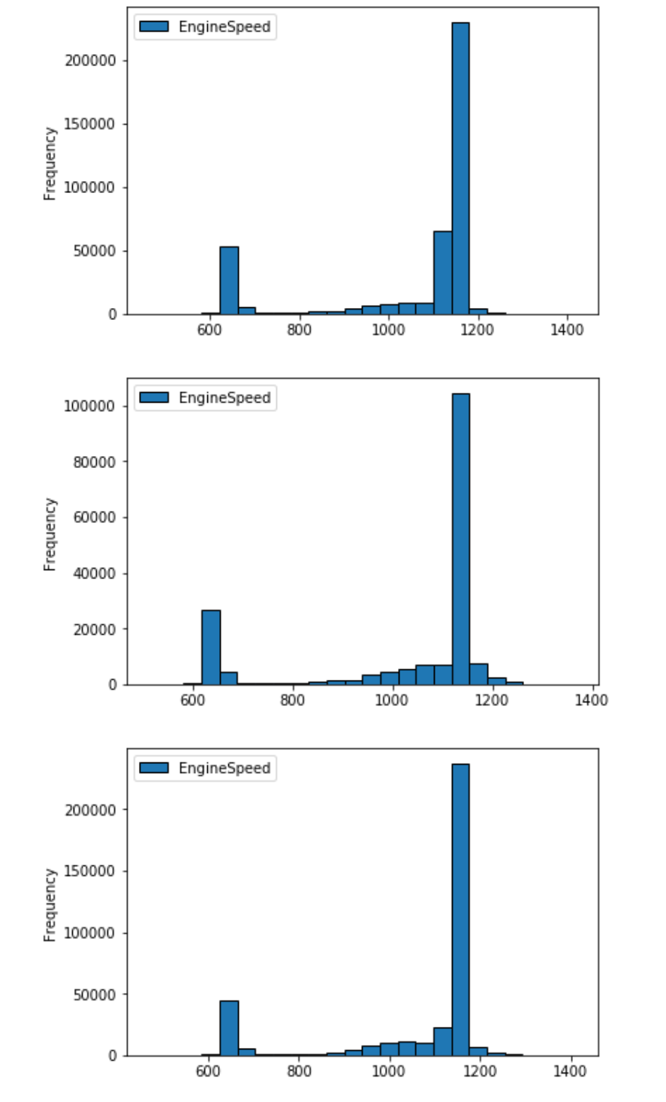
Auxiliary Power Unit
Single day distributions APU voltage and Engine speed
APU is a unit that is utilized to run comfort systems on the truck while the driver is on break, minimizing idle time fuel consumption. Traditionally all electrical power is derived from the alternator while idling at truck stops. Does the APU help any? Gaining insights on sensors associated with the apu may help determine if parasitic losses are worth having an APU unit.
12 Volt system supplied by 3 deep cells in parallel.

Slide 22
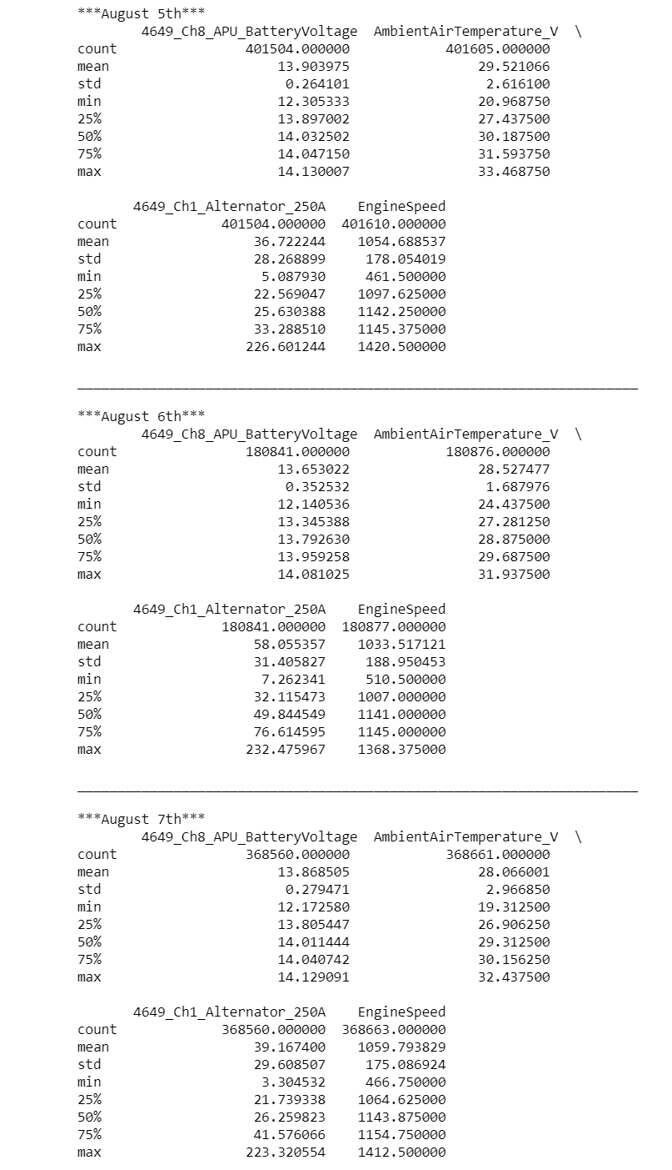
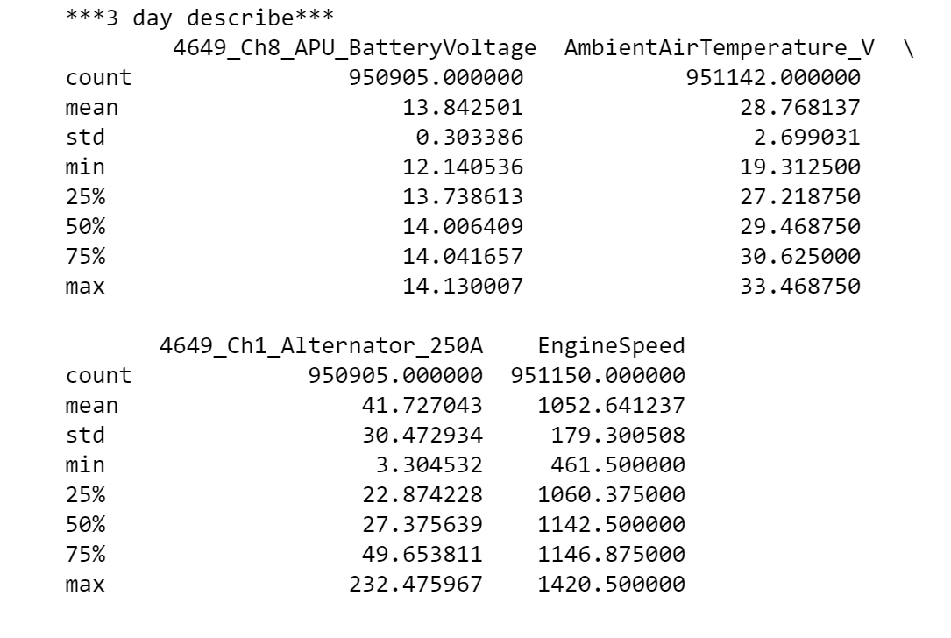
3 day and single day means, standard deviations

Slide 23
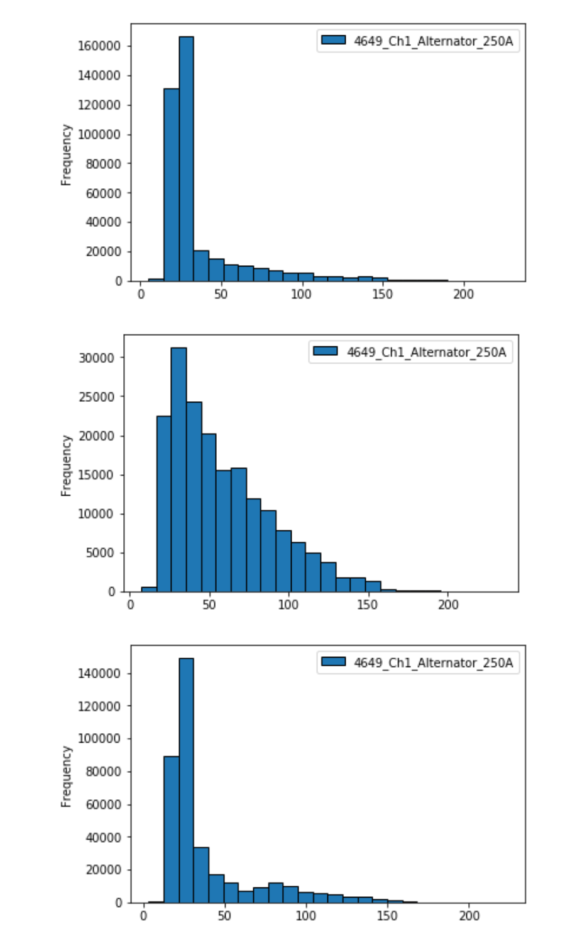
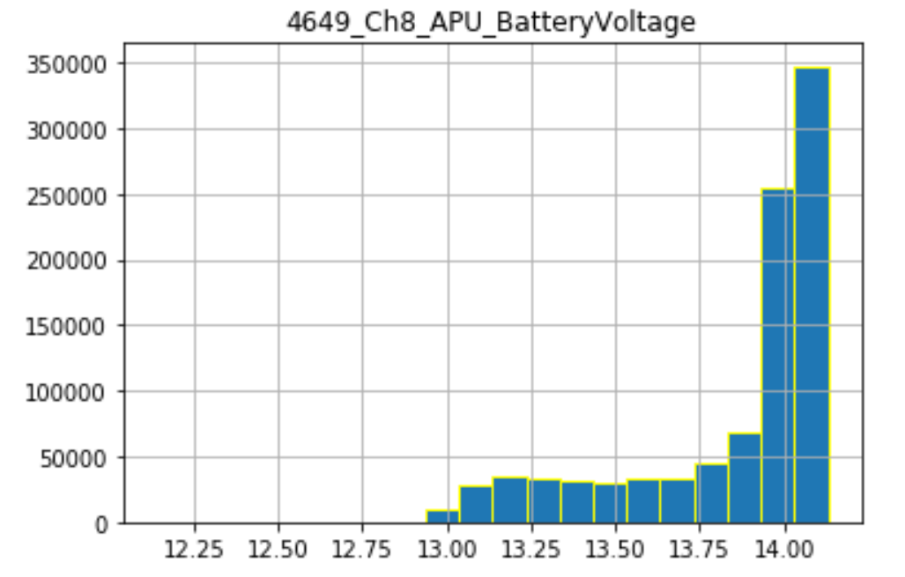
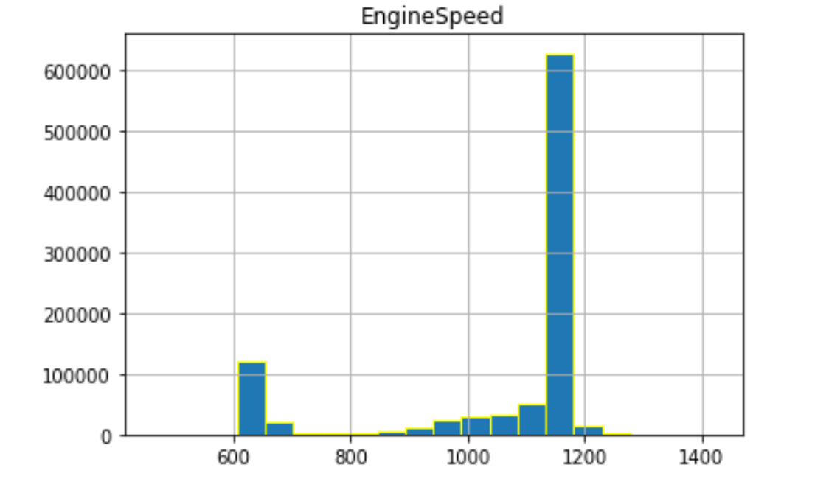
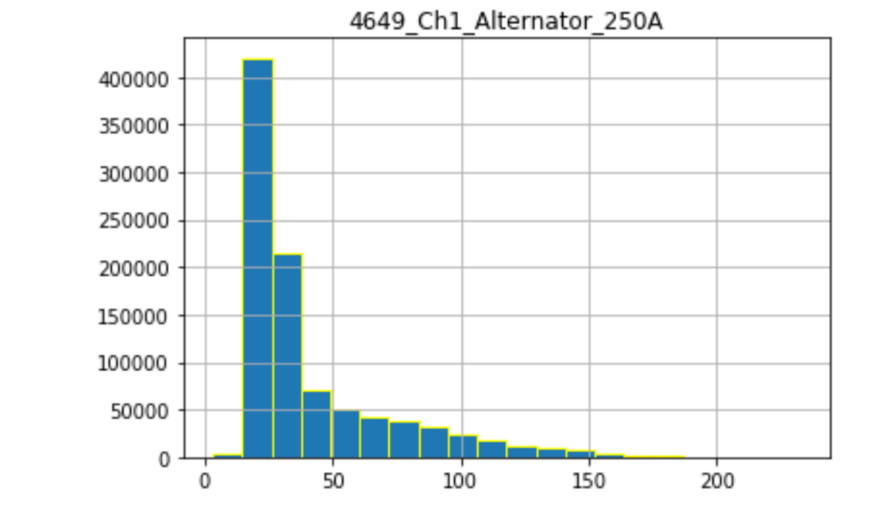
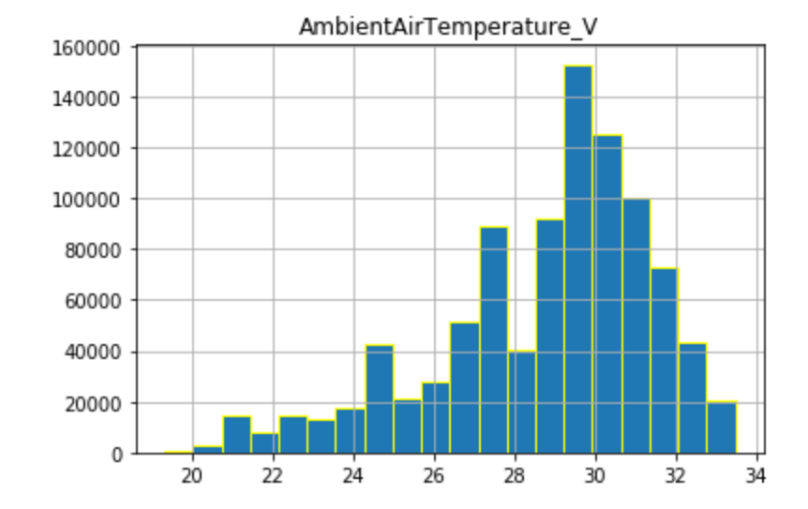
3 day distributions
Vs single day
MEAN: 1054.688
STD: 178.05
MEAN: 13.90
STD: 0.26
MEAN: 29.52
STD: 2.61
MEAN: 36.72
STD: 28.26
MEAN: 13.84
STD: 0.30
MEAN: 1033.51
STD: 188.95
MEAN: 28.52
STD: 1.68
MEAN: 28.76
STD: 2.70
MEAN: 13.65
STD: 0.35
MEAN: 1052.64
STD: 179.30
MEAN: 58.05
STD: 31.40
MEAN: 41.72
STD: 30.47
MEAN: 1059.79
STD: 175.08
MEAN: 28.07
STD: 2.96
MEAN: 13.86
STD: 0.28
MEAN: 39.16
STD: 29.60

Slide 24
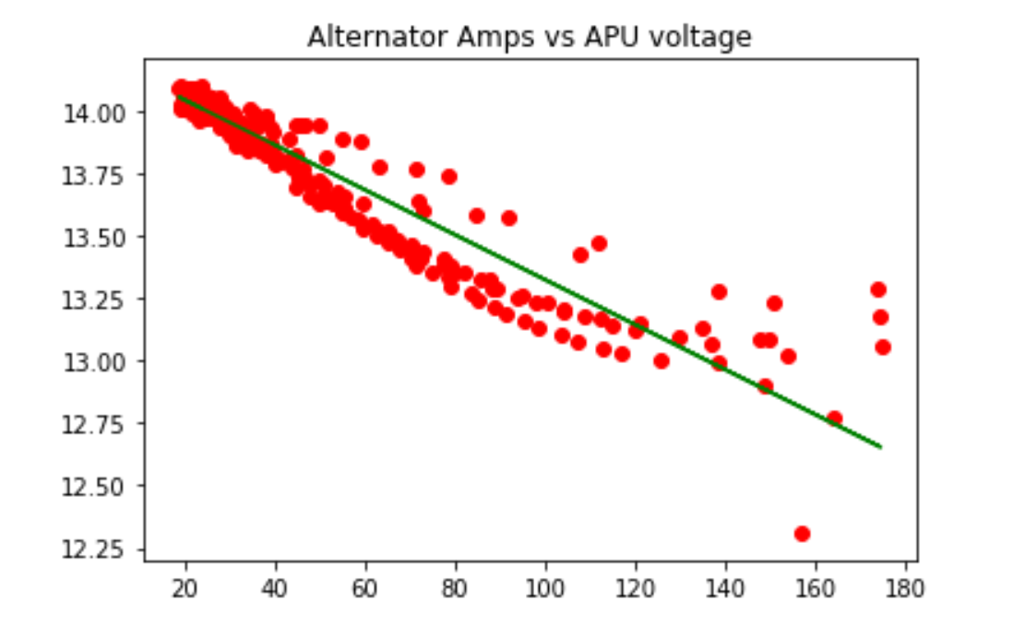
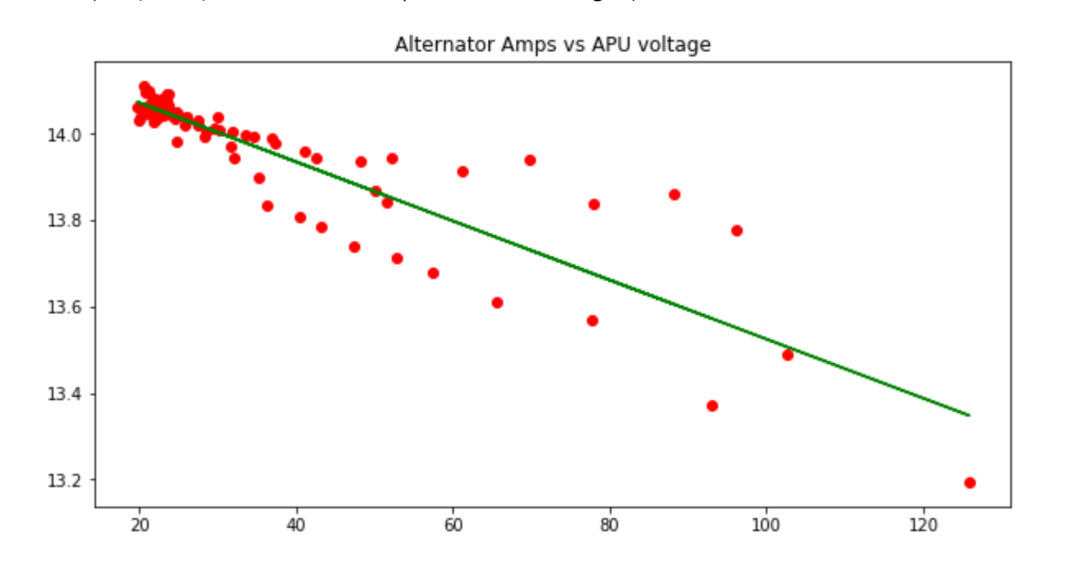
APU: Investigations and ideas!
At any given time when the engine speed is less than idle(off) the apu batteries should be discharging.
Any time the engine speed is greater than idle the batteries should be charging or charged.
As batteries discharge they typically will have a drop in voltage. Lets see a scatter plot of alternator vs battery voltage
3 DAY
1 day

Slide 25
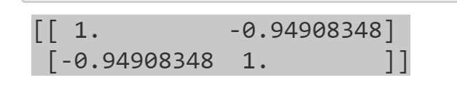

Correlation
APU/Alternator correlation matrix
APU/Alternator Covariance matrix
This shows a strong negative relationship for the APU unit and the alternator (charging)

Slide 26



Lead Acid battery charging cycle with Time Series
Source: DigiKey
https://www.digikey.com/eewiki/display/Motley/Charging+Lead+Acid+Battery+Basics

Slide 27


More scatter plots w fitted line
Since voltage and amperage are related, investigating temperature and engine speed vs APU to see if there is any correlation. The lack of correlation between these two metrics and the apu will need more discussion with Volvo, as we would assume we would see correlation with engine speeds and APU and maybe slight correlation with temperature.
*APU may be temperature controlled *Engine speed may be a different metric than what is assumed by the name.

Slide 28

Ambient Temp and Engine Speed vs APU
Correlation

Slide 29
1 Tailed T testing and P-value
Null hypothesis: The 3 day sample mean from the APU voltage is 13.82 is higher than the population APU Voltage mean.
The calculated p-value is -6.11e-13 which is well less than .05 significance level, so we can reject the null hypothesis indicating that with 95% confidence the sample mean will be lower than the population mean.

Slide 30
Errors and more
APU: Need a metric that only operates when alternator is off. Investigation into data, as wells as discussions with Volvo engineers revealed that the data may not include sensors that accurately isolate the APU.
APU: A capacity metric would be nice.
GPS and Wheelbase speed outliers.
Other outliers when truck is stopped or when a sensor first starts.

